Slide 1
Thesis Meeting
Week 4

Slide 2
Positional Uncertainty of Isocontours: Condition Analysis and Probabilistic Measures
Kai Po¨thkow and Hans-Christian Hege, Member, IEEE
ABSTRACT:
In science, engineering, and medicine, data is often uncertain — meaning it might have errors or variability. Even so, we still need to make decisions based on that uncertain data. While we already have good tools for visualizing regular data, there aren't many tools that help us see and understand uncertainty, especially in 2D and 3D images or models.
This research offers new mathematical methods to handle and visualize uncertain data. It focuses on things called isocontours, which are lines (or surfaces) that connect points with the same value — like the lines on a weather map showing temperature.
Positional Uncertainty of Isocontours: Condition Analysis and Probabilistic Measures

Slide 3
Uncertainty in Physical Measurements:
In a measurement where significant random errors can occur, an observed value may, by chance, be very close to the true value. In this case the error is low, while the uncertainty (assessed by repeated measurements) is high[1].
Systematic Errors: Systematic errors are like constant let say every time you measure height using a biased scale you get the height by +2 cm. everytime it is +2 you cannot find only uisng this scale.
Random Errors:Every time you measure something, you get a slightly different value — even if the thing you're measuring hasn’t changed
observed value = true value + random error

Slide 4
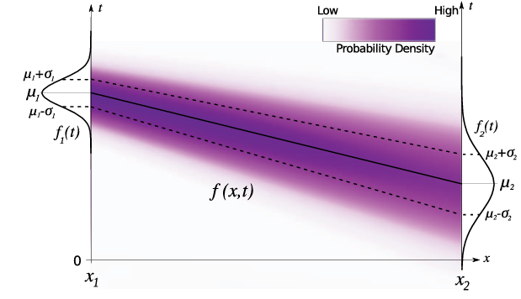
Discretely Sampled Uncertain Spatial Data
Using ensemble dataset we calculate mean and variance at every grid point
Uncertain Data in a Continuous Spatial Domain
The main problem in continous field we donot have probability distribution at every location
So in the paper they propose Spatial Interpolation of PDFs
In this method they interpolate the means and variances.
The figure below explains clearly

Slide 5
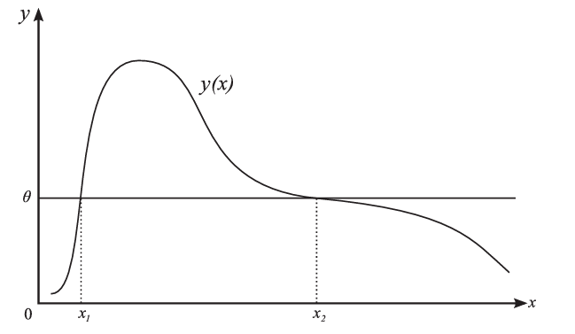
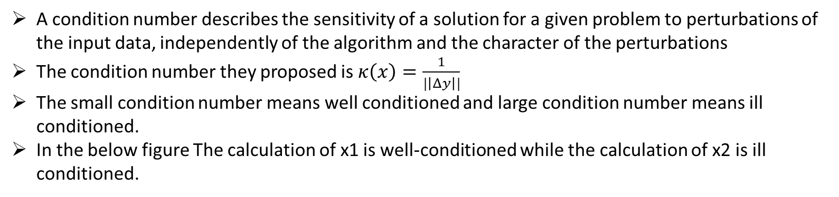
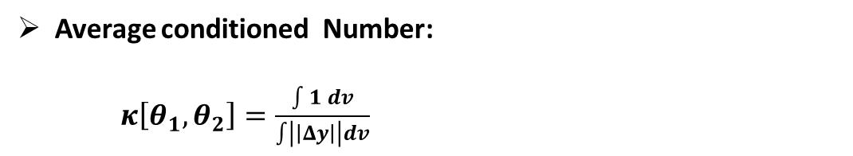
Numerical Condition of Isocontours:
A condition number describes the sensitivity of a solution for a given problem to perturbations of the input data, independently of the algorithm and the character of the perturbations
The condition number they proposed is $κ\left(x\right)=\frac{1}{|\left|Δy\right||}$
The small condition number means well conditioned and large condition number means ill conditioned.
In the below figure The calculation of x1 is well-conditioned while the calculation of x2 is ill conditioned.
Average conditioned Number:
$κ\left[θ_{1},θ_{2}\right]=\frac{\int{1 dv}}{\int{\left|\left|Δy\right|\right|dv}}$

Slide 6
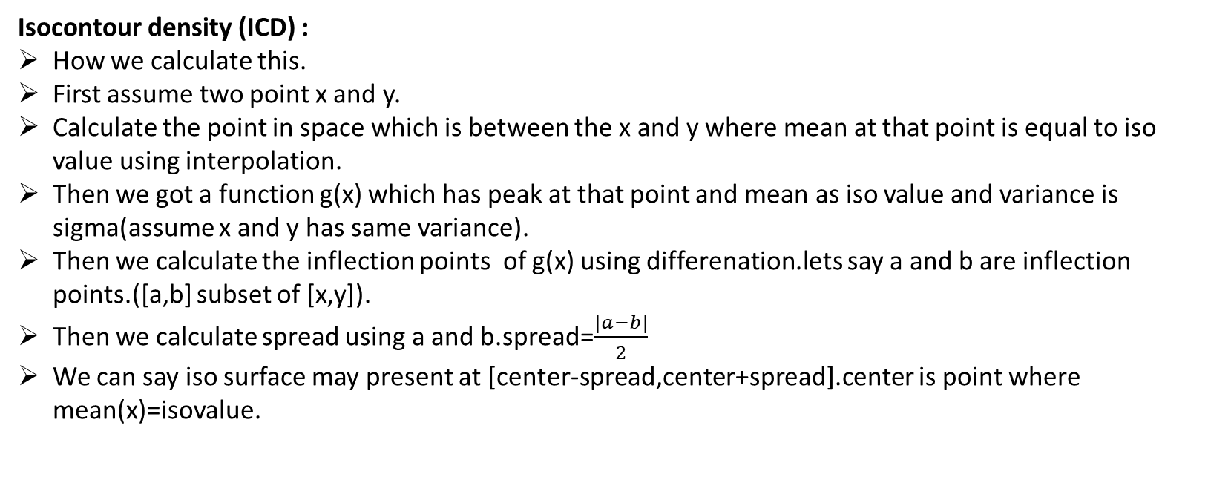
UNCERTAIN ISOCONTOURS
In this section they propose two terms.
Isocontour Density(ICD)
Level-Crossing Probability Field(LCP)
Isocontour density (ICD) :
How we calculate this.
First assume two point x and y.
Calculate the point in space which is between the x and y where mean at that point is equal to iso value using interpolation.
Then we got a function g(x) which has peak at that point and mean as iso value and variance is sigma(assume x and y has same variance).
Then we calculate the inflection points of g(x) using differenation.lets say a and b are inflection points.([a,b] subset of [x,y]).
Then we calculate spread using a and b.spread=$\frac{|a−b|}{2}$
We can say iso surface may present at [center-spread,center+spread].center is point where mean(x)=isovalue.

Slide 7
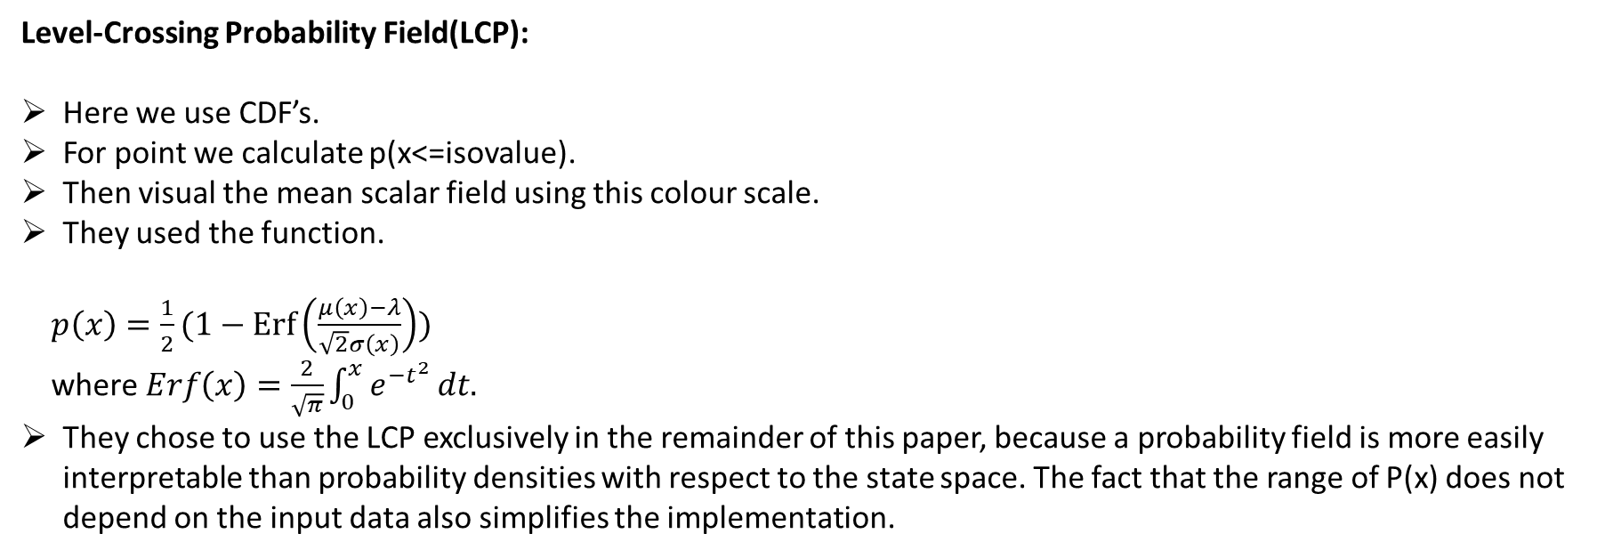
Level-Crossing Probability Field(LCP):
Here we use CDF’s.
For point we calculate p(x<=isovalue).
Then visual the mean scalar field using this colour scale.
They used the function.
$p\left(x\right)=\frac{1}{2}(1−\operatorname{Erf}\left(\frac{μ\left(x\right)−λ}{\sqrt{2}σ\left(x\right)}\right))$
where $Erf\left(x\right)=\frac{2}{\sqrt{π}}\int_{0}^{x}{e^{{−t}^{2}}}dt.$
They chose to use the LCP exclusively in the remainder of this paper, because a probability field is more easily interpretable than probability densities with respect to the state space. The fact that the range of P(x) does not depend on the input data also simplifies the implementation.

Slide 8
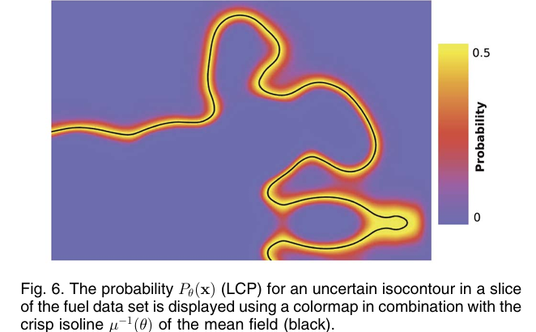
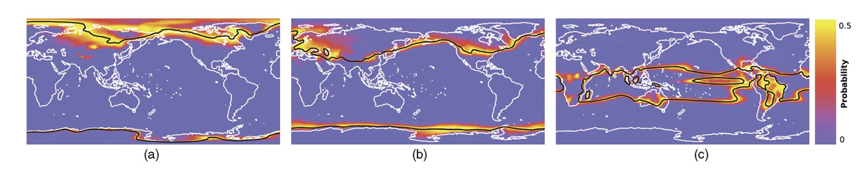
Results
FUEL DATASET
CLIMATE DATASET

Slide 9
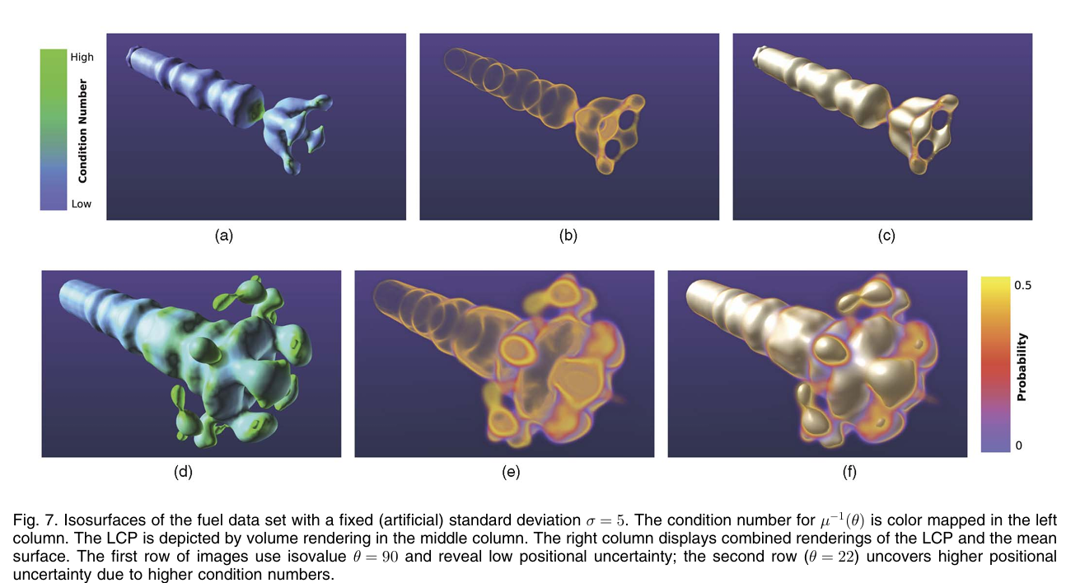

Slide 10
Probabilistic Marching Cubes
In this paper they calculate the level crossing probability for every ἠ-cell.
0-cell means point
1-cell means line
2-cell means rectangle
3-cell means cube
To explain about paper I am taking cube grid structure.
We have 8 points for a cube.
Let say at every grid point we sigma and mean. We are treating value as random variable.
Then calculate the multivariant gaussian distribution for this cube by using 8-points distributions.
There is some correlation between the points.
It has mean with 8 columns and covariance matix of size 8*8.
Now we take very case of marching cubes where no isosurface is crossing.
We calculate p(crossing)=1-p(no crossing).
P(no crossing)=p(all points below isovalue)+p(all points above isovalue).
For multivariant distributions it is difficult to calculate.
So authours computed level crossings by Monte-Carlo sampling.

Slide 11
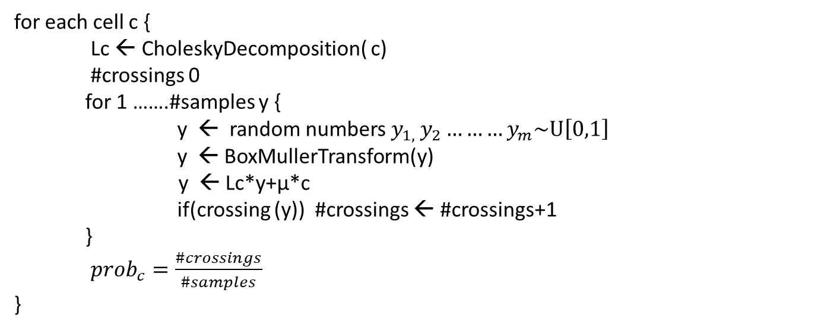
Computing crossing probabilities using monte carlo sampling:
for each cell c {
Lc ← CholeskyDecomposition( c)
#crossings 0
for 1 …….#samples y {
y ← random numbers $y_{1, }y_{2}………y_{m}\sim U\left[0,1\right]$
y ← BoxMullerTransform(y)
y ← Lc*y+µ*c
if(crossing (y)) #crossings ← #crossings+1
}
${prob}_{c}=\frac{\#crossings}{\#samples}$
}
We visualize mean scalar field with this crossing probability color scale

Slide 12
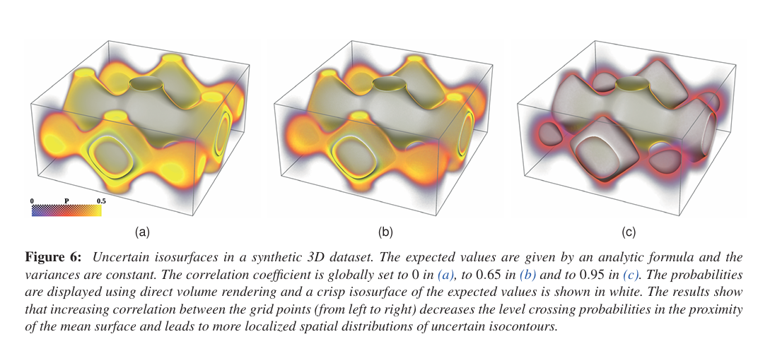
RESULTS

Slide 13
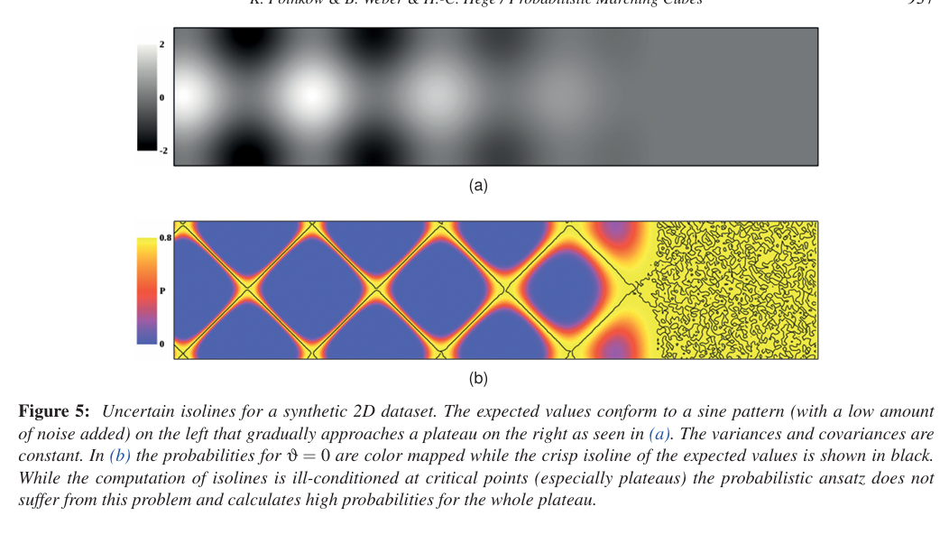

Slide 14
CODE PART DONE IN THIS WEEK:
I think if sirenent performs better for gmm data then using the same we can get better result for histogram also.
I have written code for gmm using sklearn library.
Without multiprocessing it has take 28 hours.
With multi processing with 16 cpu cores it has taken 15 hours.
There is no batch EM inbuilt algorithms
I added the softmax to the weigths of gaussian components after prediction.
We have to add softmax layer so I didn’t scale the weights to [-,1,1].
By this also I did not got the better results.
So I changed loss function mse to mse for predicted means and stds. Then I used kl divergence loss for weights.
In this model results got worse.
Now I removed the final layer and added three different heads one for means ,one for stds,one for weigths.
I think there is slight improvement in case of teardrop dataset.
For 150 neurons I tried different combinations of learning rate but I got worst results.
I observed when I train the model for 1000 epochs the loss is constant across all the epochs after a certain period of time. They might be hit by a pleatue region.
The results of experiments are in the next slide.
For every model no_of_blocks are same ( 6 blocks).

Slide 15
Tear_drop_gmm.vti
INPUTS->[-1,1]
OUTPUTS->[-1,1]
LR=5e-5
Without softmax,epochs:500
INPUTS->[-1,1]
OUTPUTS->[-1,1]
LR=5e-5
With softmax ,epochs:500,modified loss function
variable | psnr
GMM_Mean0 | 46.26267
GMM_Mean1 | 46.24679
GMM_Mean2 | 46.24057
GMM_Std0 | 37.625328
GMM_Std1 | 40.154747
GMM_Std2 | 37.529823
GMM_Weight0 | 25.394531
GMM_Weight1 | 22.578516
GMM_Weight2 | 26.656757
Average psnr : | 36.521084
RMSE: | 0.0230344
variable | psnr
GMM_Mean0 | 39.01148
GMM_Mean1 | 38.99788
GMM_Mean2 | 38.989925
GMM_Std0 | 32.857815
GMM_Std1 | 32.606663
GMM_Std2 | 32.408962
GMM_Weight0 | 31.345173
GMM_Weight1 | 26.91307
GMM_Weight2 | 32.142612
Average psnr | 33.91929
RMSE: | 0.03147983

Slide 16
Teadrop_gmm.vti
with 300 neurons and no SoftMax on weights
Epochs 200
Same with 200 epochs with 150 neurons with learning_rate=0.0001
variable | psnr
GMM_Mean0 | 54.046227
GMM_Mean1 | 54.036003
GMM_Mean2 | 53.997253
GMM_Std0 | 48.116608
GMM_Std1 | 44.062225
GMM_Std2 | 48.846146
GMM_Weight0 | 44.85743
GMM_Weight1 | 43.66662
GMM_Weight2 | 45.742477
Average psnr : | 48.596775
RMSE: | 0.0061960206
variable | psnr
GMM_Mean0 | 48.13282
GMM_Mean1 | 48.116856
GMM_Mean2 | 48.109932
GMM_Std0 | 37.58511
GMM_Std1 | 40.232815
GMM_Std2 | 37.509106
GMM_Weight0 | 27.544306
GMM_Weight1 | 22.840757
GMM_Weight2 | 28.772413
Average psnr : | 37.649345
RMSE: | 0.021135004

Slide 17
ISABEL_GMM.VTI
Loss function=mse+kl-loss
Neurons 150
Epochs 500,softmax
Loss function=mse
Neurons 150
Epochs 1000,softmax
variable | psnr
GMM_Mean0 | 45.7914163975473
GMM_Mean1 | 47.43062769305353
GMM_Mean2 | 48.43320520421297
GMM_Std0 | 43.24335929678513
GMM_Std1 | 43.98318425476242
GMM_Std2 | 44.78677905407444
GMM_Weight0 | 25.887881683720654
GMM_Weight1 | 24.486073513625534
GMM_Weight2 | 20.94072603769441
Average psnr : | 38.33147257060848
RMSE: | 0.028375803
varibale | psnr
GMM_Mean0 | 48.0745336546012
GMM_Mean1 | 49.822628956132235
GMM_Mean2 | 50.85064017436572
GMM_Std0 | 44.34573003946018
GMM_Std1 | 45.38205216983044
GMM_Std2 | 46.01500427197011
GMM_Weight0 | 25.747836902290718
GMM_Weight1 | 24.486073513625534
GMM_Weight2 | 20.84138152536874
Average psnr : | 39.5014958986541
RMSE: | 0.028264433

Slide 18
Three heads method
scalling inputs->[-1,1]
scalling all ouputs->[-1,1]
default siren mdoel
model with 320
without softmax
Epochs 200,teardrop_gmm.vti
Teardrop_gmm.vti
With decay interval at 30
No of neurons =200
Epochs:400
variable | psnr
GMM_Mean0 | 46.77740233679642
GMM_Mean1 | 46.53684606893467
GMM_Mean2 | 46.74438307675439
GMM_Std0 | 37.44560993069675
GMM_Std1 | 39.60769379100644
GMM_Std2 | 37.241562085821066
GMM_Weight0 | 37.17669055635848
GMM_Weight1 | 36.262924747491176
GMM_Weight2 | 38.03786312920377
Average psnr : | 40.64788619145146
RMSE: | 0.008811643
variable | psnr
GMM_Mean0 | 51.59409
GMM_Mean1 | 51.780205
GMM_Mean2 | 51.70666
GMM_Std0 | 38.846436
GMM_Std1 | 44.100918
GMM_Std2 | 38.885666
GMM_Weight0 | 56.099514
GMM_Weight1 | 56.4625
GMM_Weight2 | 55.9844
Average psnr : | 49.4956
RMSE: | 0.012039199

Slide 19
#scalling inputs->[-1,1]
#ouputs stds,means->[-1,1]
# no softmax
# model with 320
teardrop_gmm.vti
variable | psnr
GMM_Mean0 | 55.837547
GMM_Mean1 | 55.80872
GMM_Mean2 | 55.781593
GMM_Std0 | 48.56475
GMM_Std1 | 44.175056
GMM_Std2 | 49.326965
GMM_Weight0 | 47.204666
GMM_Weight1 | 45.305687
GMM_Weight2 | 47.9282
Average psnr : | 49.992573
RMSE: | 0.0058098924

